Slide 1

Shield Controller

Slide 2
Index
Introduction…………………………………………………………………………………………………………………………………………3
Background ………………………………………………………………………………………………………………………………………..4
Objective …………………………………………………………………………………………………………………………………………….5
Purpose & Scope ………………………………………………………………………………………………………………………………..6
Problem definition ……………………………………………………………………………………………………………………………..7
Requirement specification ………………………………………………………………………………………………………………...8
Hardware software requirements ……………………………………………………………………………………………….9-10
D F D ……………………………………………………………………………………………………………………………………………11-19
E R Diagram ……………………………………………………………………………………………………………………………………..20
Data dictionary ……………………………………………………………………………………………………………………………21-22
Screen shots ………………………………………………………………………………………………………………………………..23-34
Limitations of System ………………………………………………………………………………………………………………..…….35

Slide 3
Introduction
On the digital century where technology reaches kids hands, guardians may worry about the effect of this very open world on their kids’ development. They may worry about the detrimental effect of this technology on their educational, emotional and social developments. To help overcome some of these worries, guardians may need to have some controlling technology to check and track their children usage for the personal devices.

Slide 4
Background
On the digital century where technology reaches kids hands, guardians may worry about the effect of this very open world on their kids’ development. They may worry about the detrimental effect of this technology on their educational, emotional and social developments. To help overcome some of these worries, guardians may need to have some controlling technology to check and track their children usage for the personal devices.

Slide 5
Objective
The main objective of this application is to secure the children from the addiction of mobile and bed application which creates bad impact on peoples mind.

Slide 6
Purpose
control children activities.
By using this app parent can reduce the application usage time.
Scope
The application is only for android user.
This application used by parents for controlling the activities of children or person.

Slide 7
Problem Definition
The usage of mobile devices is constantly incrementing so this application sets the time period for the usage of particular application.
The existing Application uses old technology in back-end and in this application we try to do implement new technology.

Slide 8
Requirement Specification
Parent can blocking the particular application.
Also whenever parent wants then parent can unblock the Particular application using password.

Slide 9
H/W & S/W Requirements(Client)
H/W :
RAM 2 GB
Storage min 10 MB
S/W :
Android device
Internet Connection

Slide 10
H/W & S/W Requirements(Developer)
H/W :
Windows 10 pc
RAM- 4GB
1 TB Hard Disk
Intel core I3 1.9 GHz
S/W :
Android Studio (3.3)
Java JDK (1.8.0_152)
Android SDK (27)
Visual Studio Code
Firebase (backend)

Slide 11
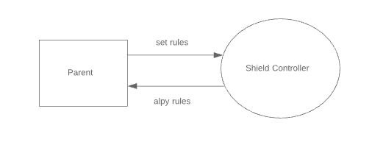
Data Flow Diagram
Context level DFD

Slide 12
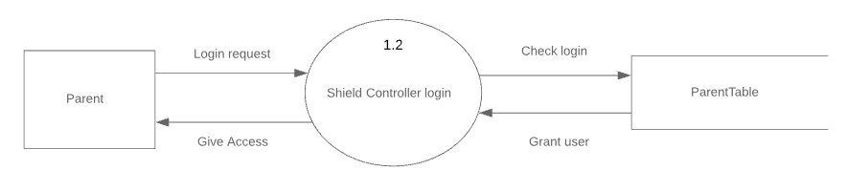
Data Flow Diagram
Login Level 1 DFD

Slide 13
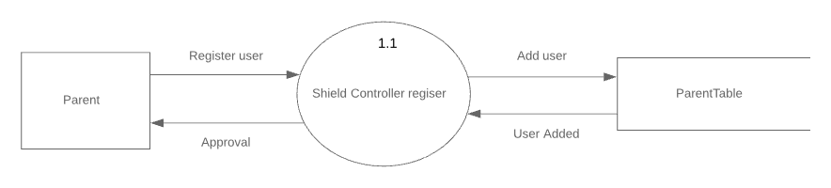
Data Flow Diagram
Registration Level 1 DFD

Slide 14
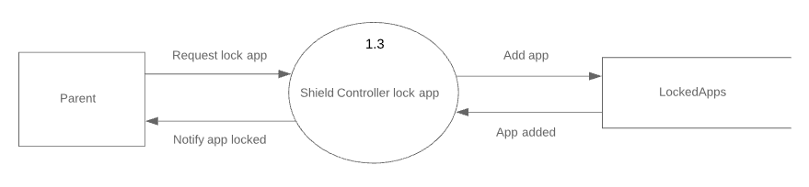
Data Flow Diagram
Lock Level 1 DFD

Slide 15
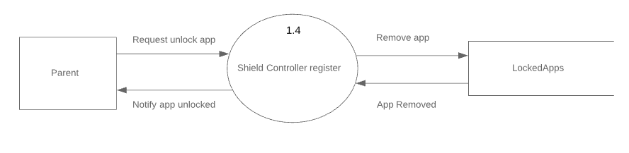
Data Flow Diagram
Unlock Level 1 DFD

Slide 16
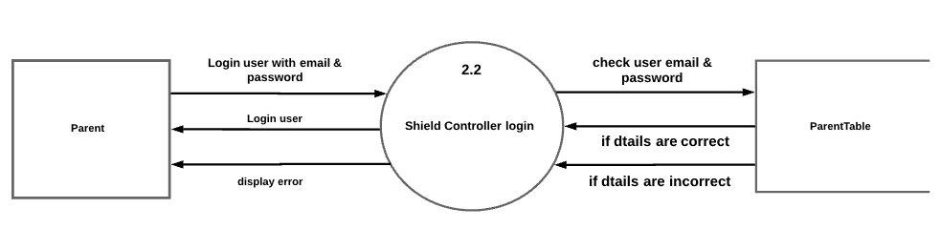
Data Flow Diagram
Login Level 2 DFD

Slide 17
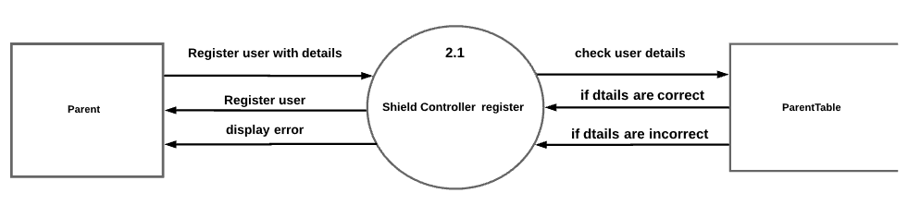
Data Flow Diagram
Registration Level 2 DFD

Slide 18
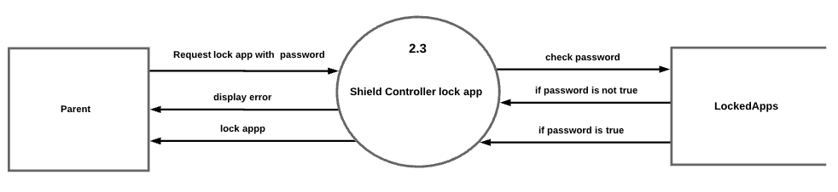
Data Flow Diagram
Lock App Level 2 DFD

Slide 19
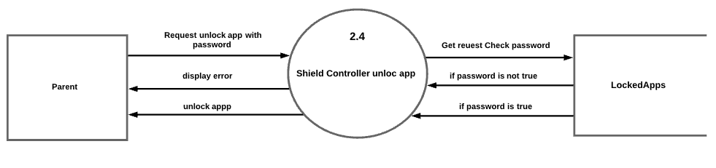
Data Flow Diagram
Unlock App Level 2 DFD

Slide 20
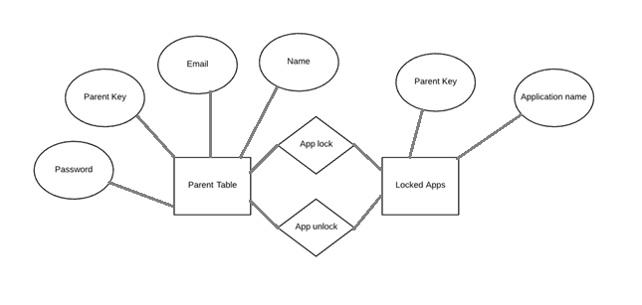
E R Diagram
Unlock App Level 2 DFD

Slide 21
Data Dictionary
Sr.no. | Field name | Data type | Size | Constraint | Description
1 | Parent key | String | - | - | Parent unique key
2 | App name | String | - | - | Name of application
Locked Apps

Slide 22
Data Dictionary
Sr.no. | Field name | Data type | size | constraint | description
1 | Parent key | String | - | - | Parent unique key
2 | User name | String | - | - | User name of the application
2 | email | String | - | - | Email of user
3 | password | String | - | - | Password for user
Parent Tabel

Slide 23
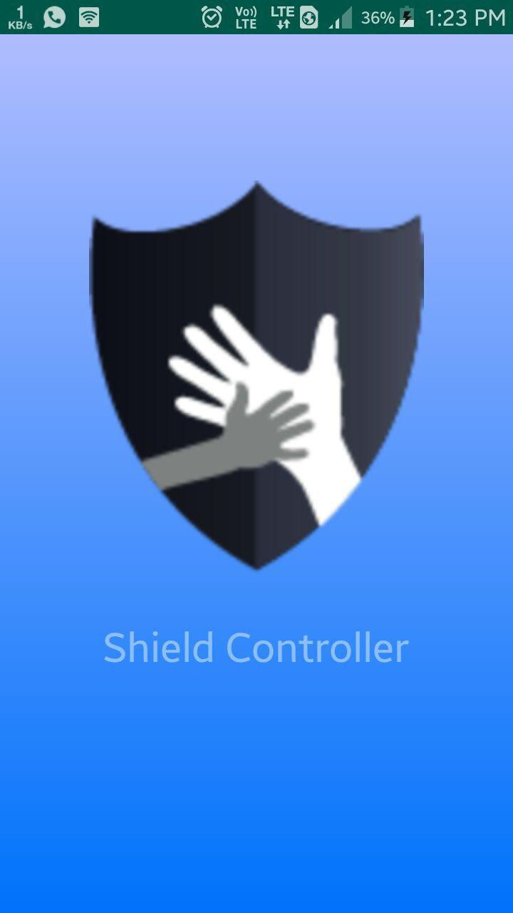
Place your screenshot here
Spalsh Screen
This is a splash screen which appears on start of an app.

Slide 24
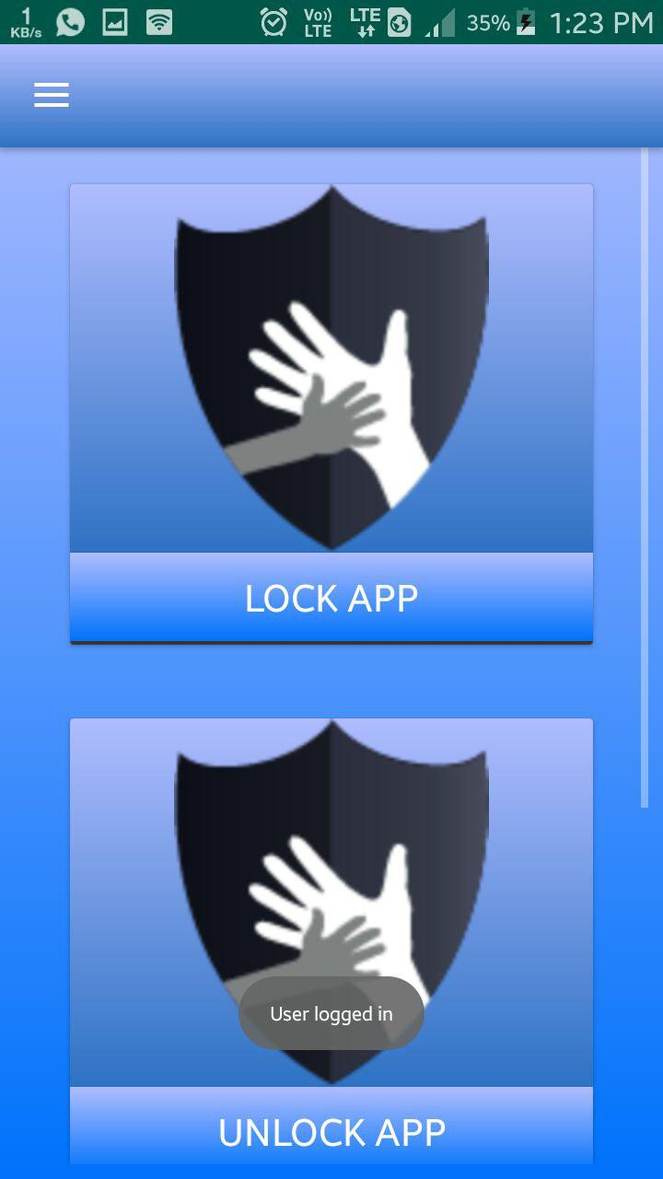
Place your screenshot here
Home Screen
The Home screen contains the features like lock app and unlock app .if lock app card is clicked then the lock screen appears the lock apps screen. .if unlock app card is clicked then the lock screen appears the unlock apps screen and the
Drawer icon opens the drawer.

Slide 25
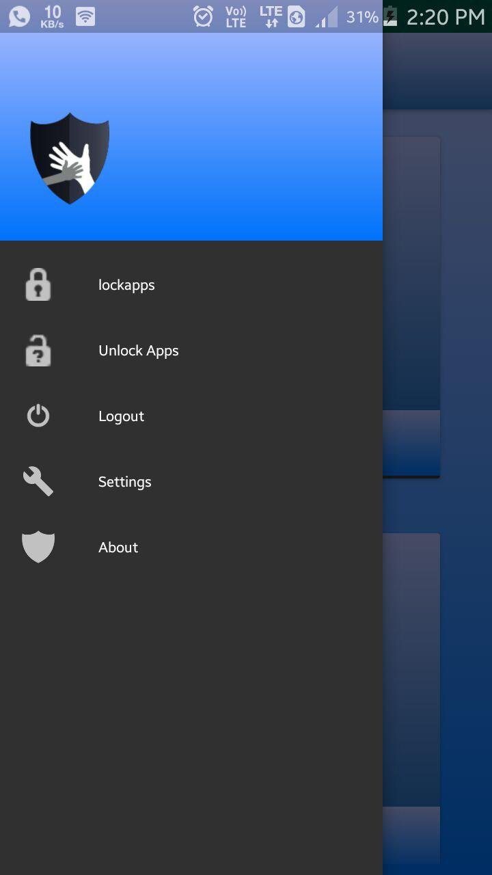
Place your screenshot here
Drawer Screen
The Drawer screen contains the lock app, logout, settings, about, and unlock app .if lock app link clicked then the lock screen appears the lock apps screen. .if unlock app link is clicked then the lock screen appears as same as lock apps and unlock apps settings and about link used to open settings and about activity if the loout link clicked then it open the logout dialog.

Slide 26
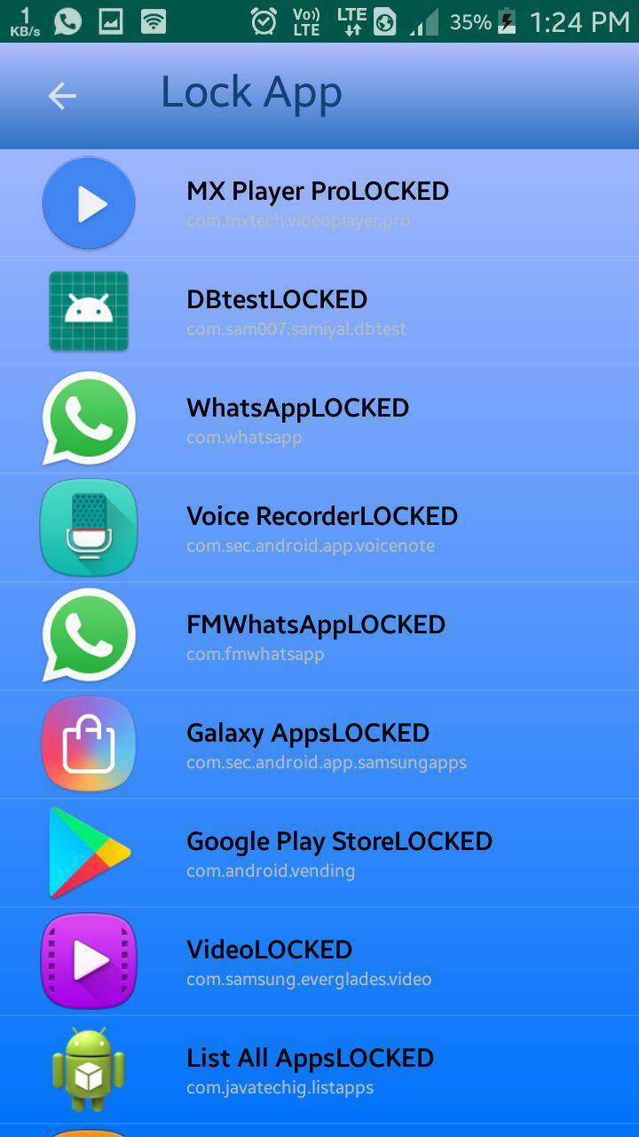
Place your screenshot here
Lock Apps Screen
Lock App Screen displays the installed apps of device and user can lock any app by clicking any app it will display lock app dialog .

Slide 27
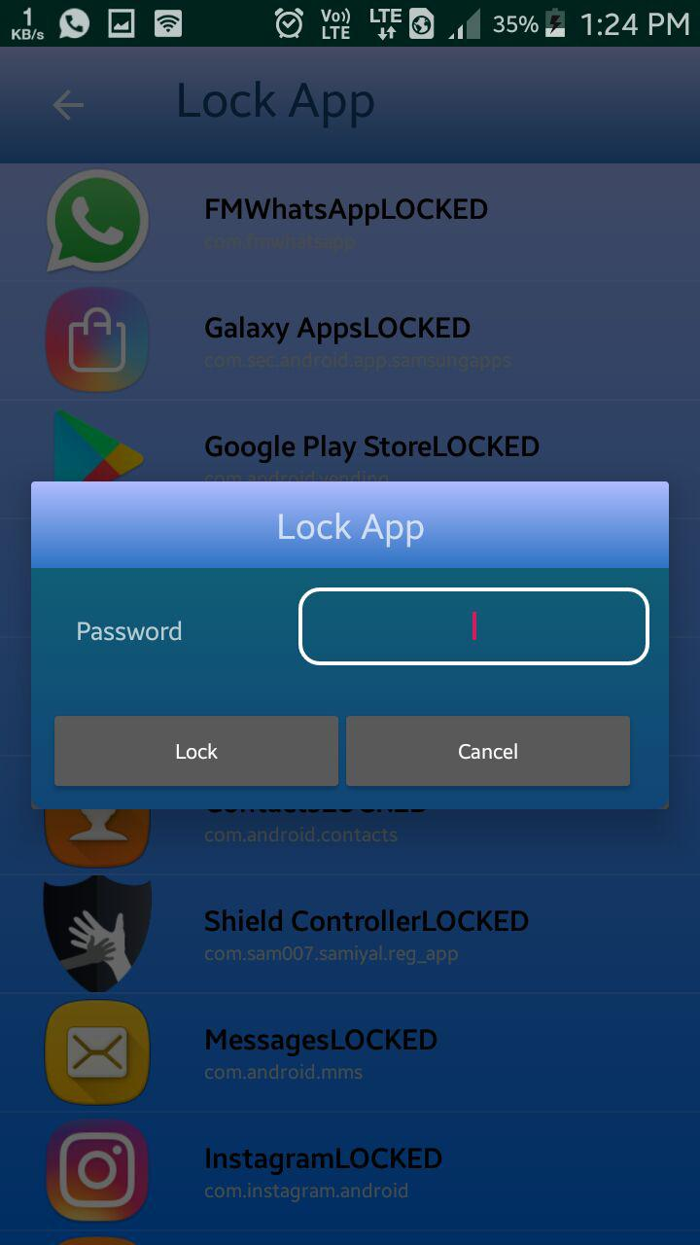
Place your screenshot here
Lock Dialog
Lock App dialog Screen is used to lock app. User have to enter correct password in order to lock app .

Slide 28
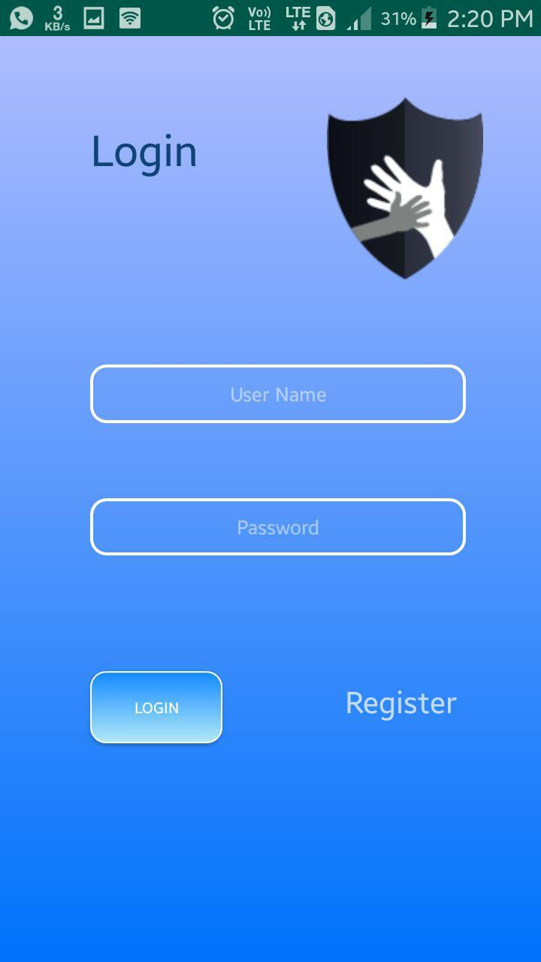
Place your screenshot here
Login Screen
The Login screen is used to login parent . In order to login parent needs to enter email and password if email and password are true then parent success fully login to app and then appears the home screen.

Slide 29
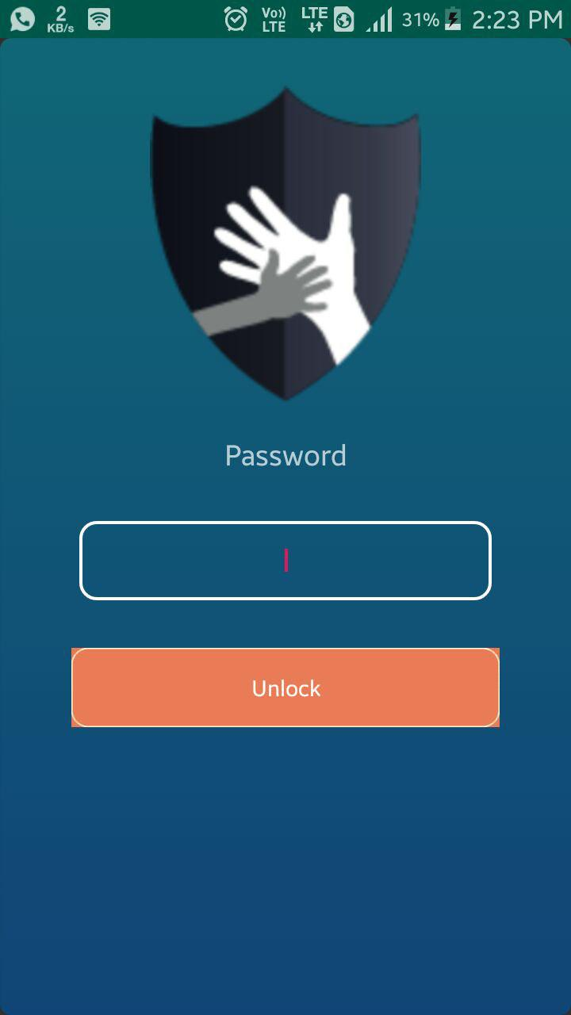
Place your screenshot here
Lock Screen
Lock screen is displayed automatically on locked app start up.

Slide 30
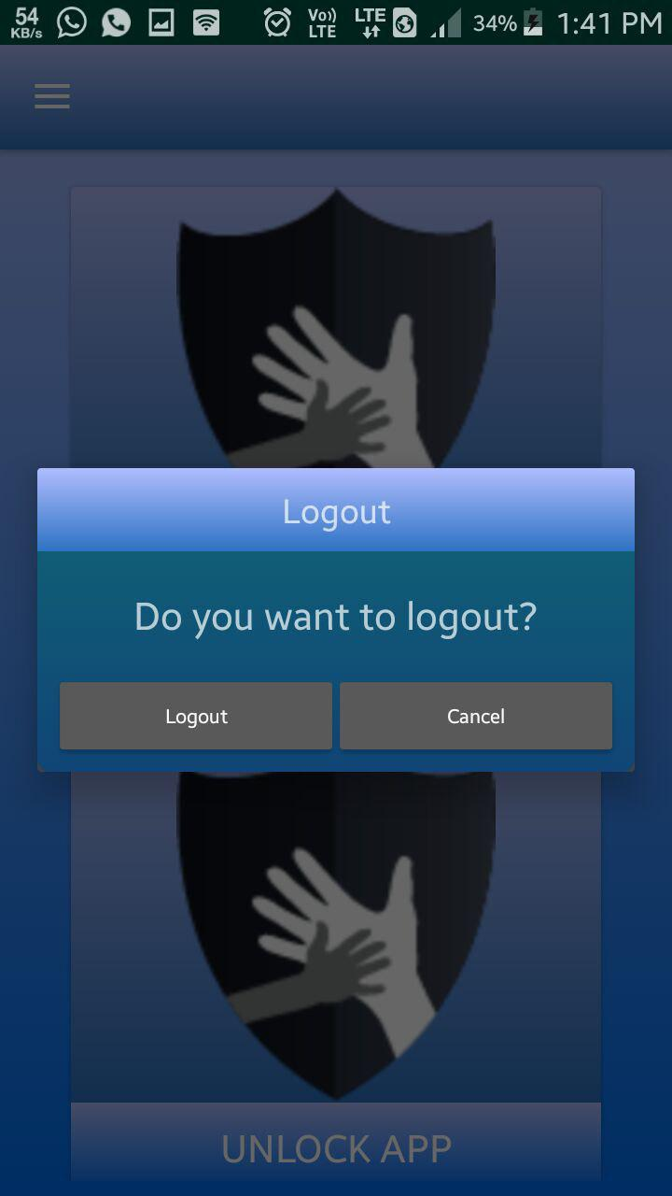
Place your screenshot here
Logout Dialog
Logout screen is used to notify the user if log out or not.

Slide 31
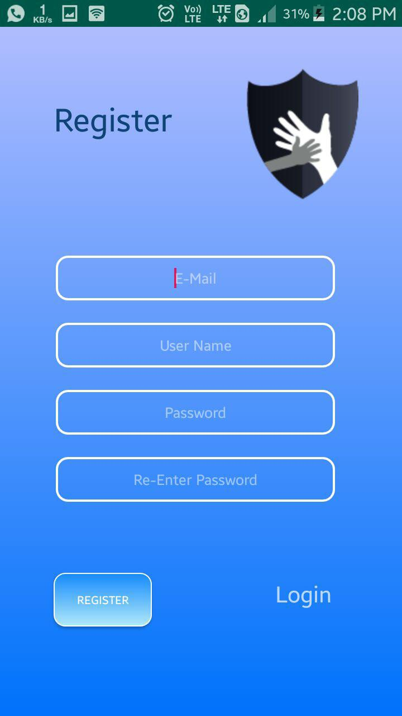
Place your screenshot here
Registration Screen
The Registration screen is used to register parent . In order to register parent needs to enter email, username and password if details are true then parent success fully registered
.

Slide 32
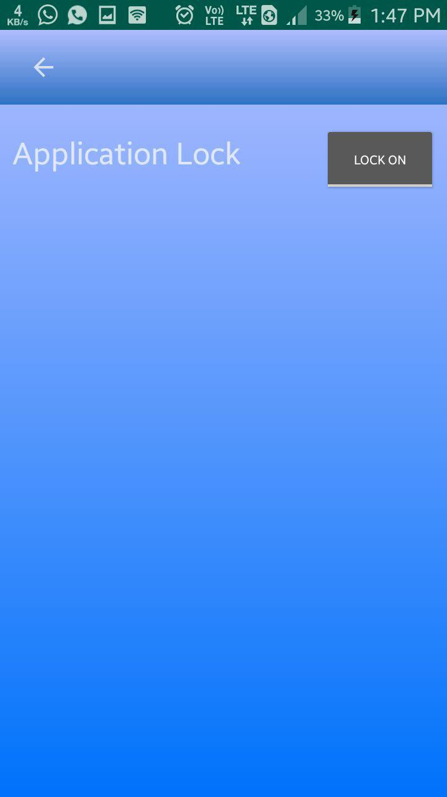
Place your screenshot here
Setting Screen
Settings screen is used to start and stop app lock
.

Slide 33
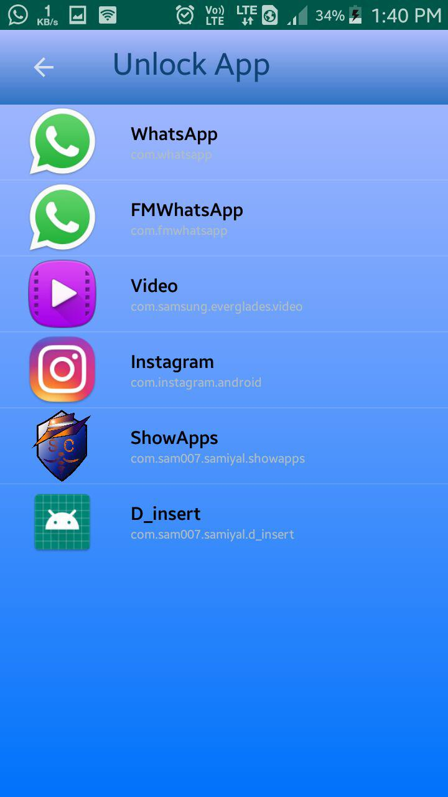
Place your screenshot here
Unlock App Screen
Unlock App Screen displays the locked apps of device and user can lock any app by clicking any app it will display unlock app dialog
.

Slide 34
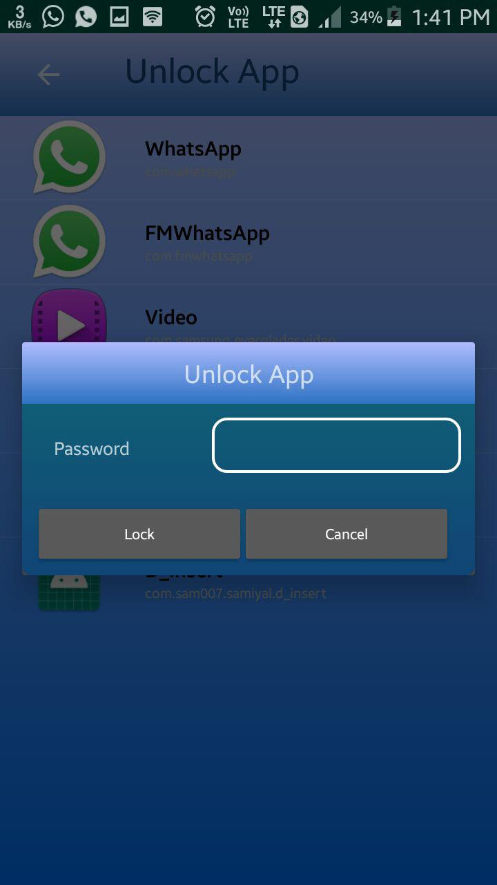
Place your screenshot here
Unlock Dialog
Unlock App dialog Screen is used to unlock app. User have to enter correct password in order to unlock app
.

Slide 35
Limitation of System
Application can be only used in Android devices.
User need to register before using this app
User need a working internet connection.
Your audience will listen to you or read the content, but won’t do both.

